Slide 1

Suraksha-Path
Where Every Second is a Lifeline
Transforming emergency response in India through AI-powered traffic management

Slide 2
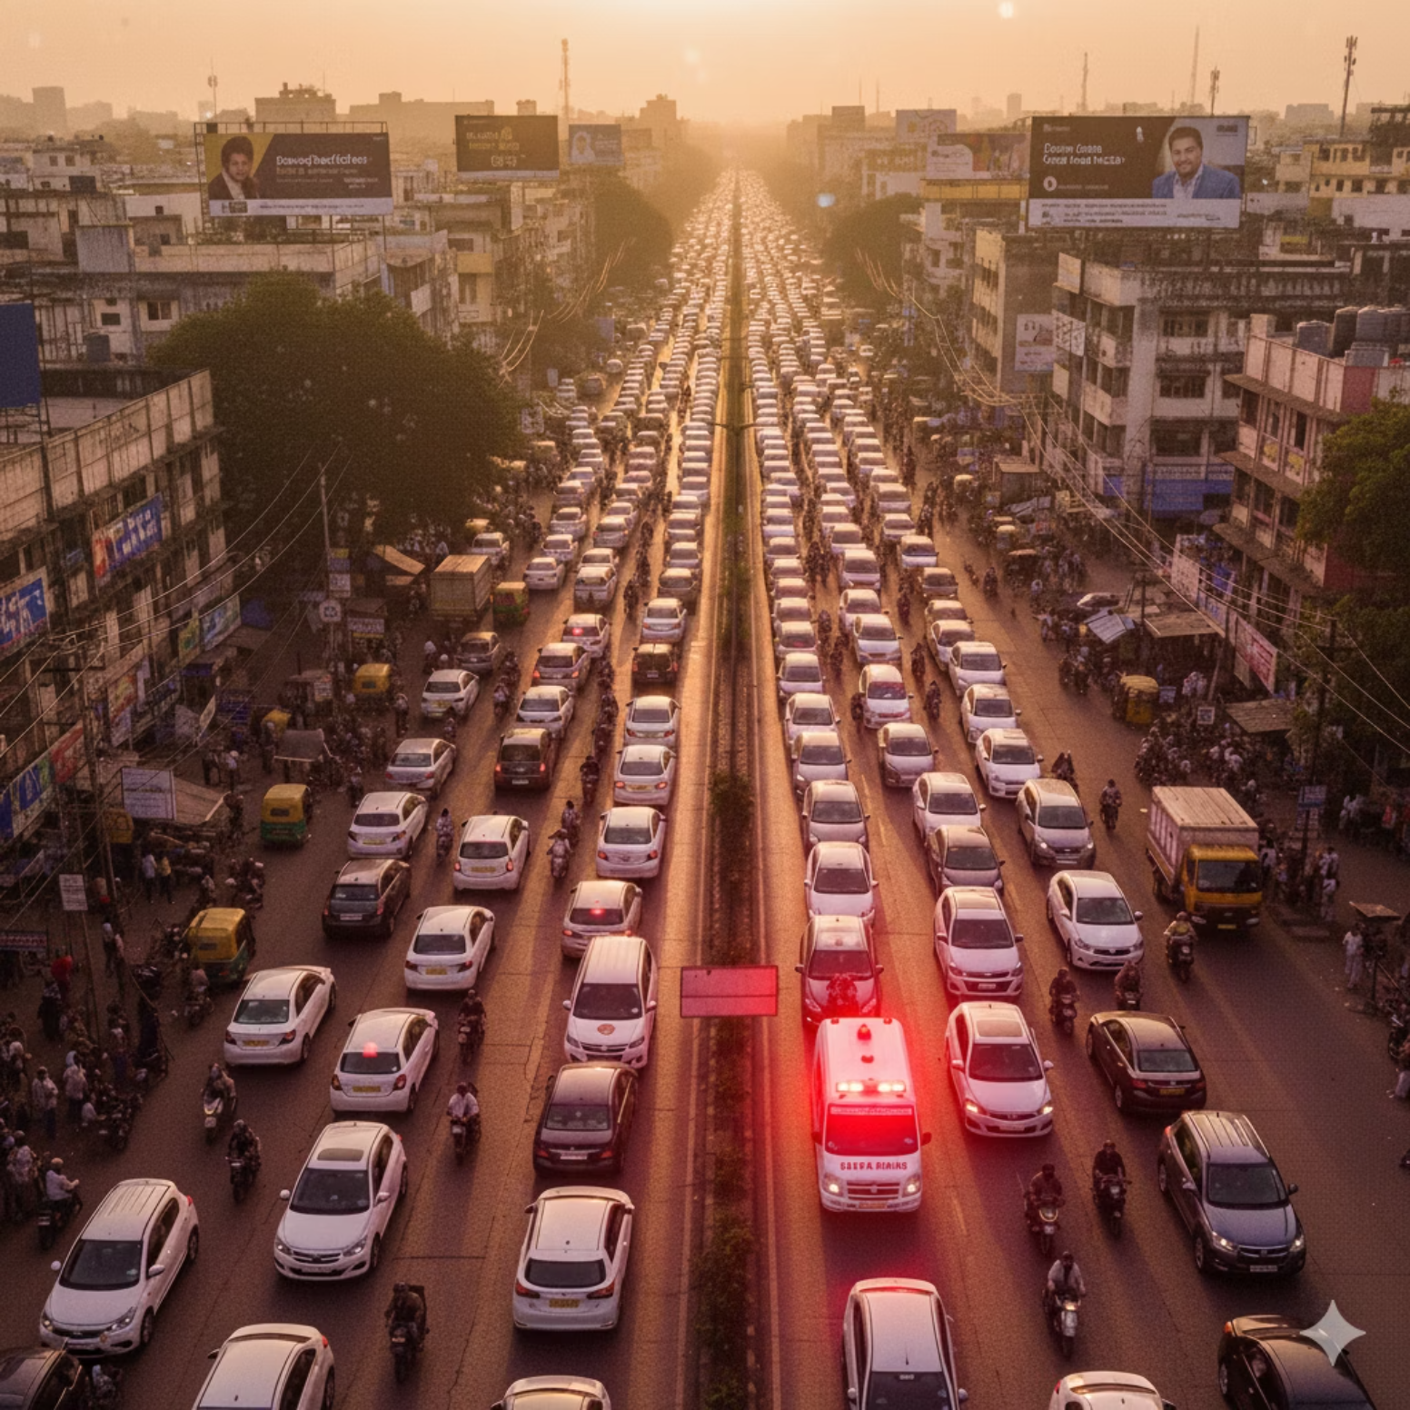
The Silent Killer on Indian Roads
450
Lives Lost Daily
Every day in India, 450 people die because ambulances get trapped in traffic. Over 30% of emergency deaths are caused by these preventable delays.
Current solutions are failing us. Manual green corridors are rare and slow. Navigation apps can't control traffic signals. People are dying while help sits motionless in gridlock.

Slide 3
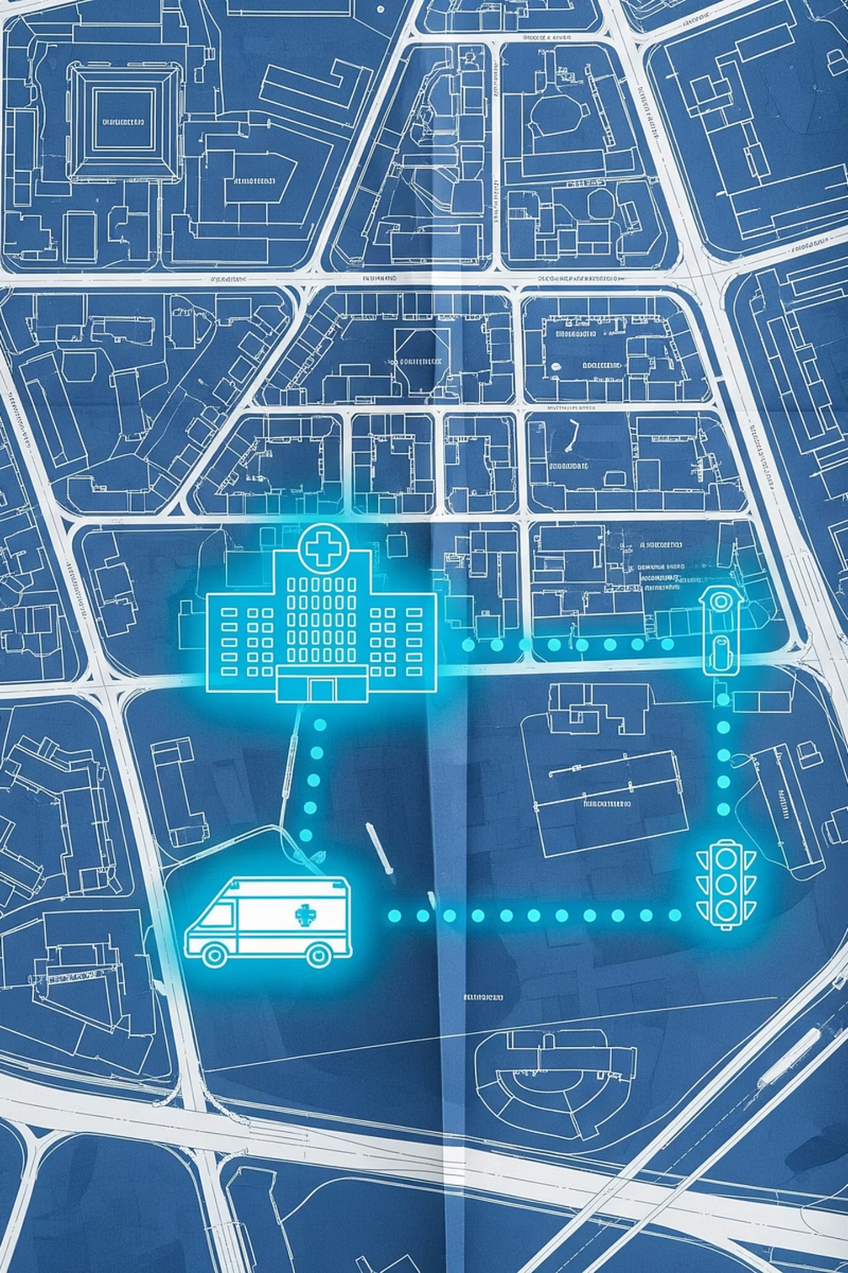



The Path to Immediate Care
Suraksha-Path is an AI and IoT-powered system that creates automatic green corridors for ambulances. Our intelligent platform combines route optimization, traffic signal control, and hospital coordination to save precious minutes when they matter most.
Ambulance Detection
DSRC-C/V2X sensors automatically identify emergency vehicles
Smart Traffic Control
AI instantly creates green corridors by controlling traffic signals
Hospital Coordination
Real-time patient data transmission ensures readiness upon arrival

Slide 4
Our Unfair Advantage
Fully Automatic
1
DSRC-C/V2X sensors detect ambulances from 1.5km away and automatically trigger green signals. No manual intervention needed.
AI-Powered Precision
2
Our AI predicts traffic patterns 5 minutes ahead and updates routes every 10 seconds—3x faster than existing apps.
Seamless Hospital Integration
3
Secure app transmits patient vitals directly to emergency rooms, reducing preparation time and improving outcomes.
While competitors offer basic navigation or manual systems, Suraksha-Path delivers end-to-end automation that works without human intervention.

Slide 5



The Brain Behind the Operation: OpenAI APIs
GPT-4o: Intelligent Reasoning
Whisper: Voice-to-Command
DALL-E: Visual Communication
Acts as the core brain for real-time reasoning and generating personalized, context-aware instructions for drivers, such as "Move left, ambulance 200m behind you." It also provides crucial multi-language support for local drivers, ensuring clear communication.
Enables hands-free voice commands from ambulance staff (e.g., "patient is critical"), converting them into structured, actionable commands for the system. This allows responders to focus on patient care without manual input.
Generates dynamic visual route heatmaps for traffic analysis and creates impactful alert posters for public awareness campaigns. This helps communicate critical information clearly and effectively to both authorities and the public.

Slide 6
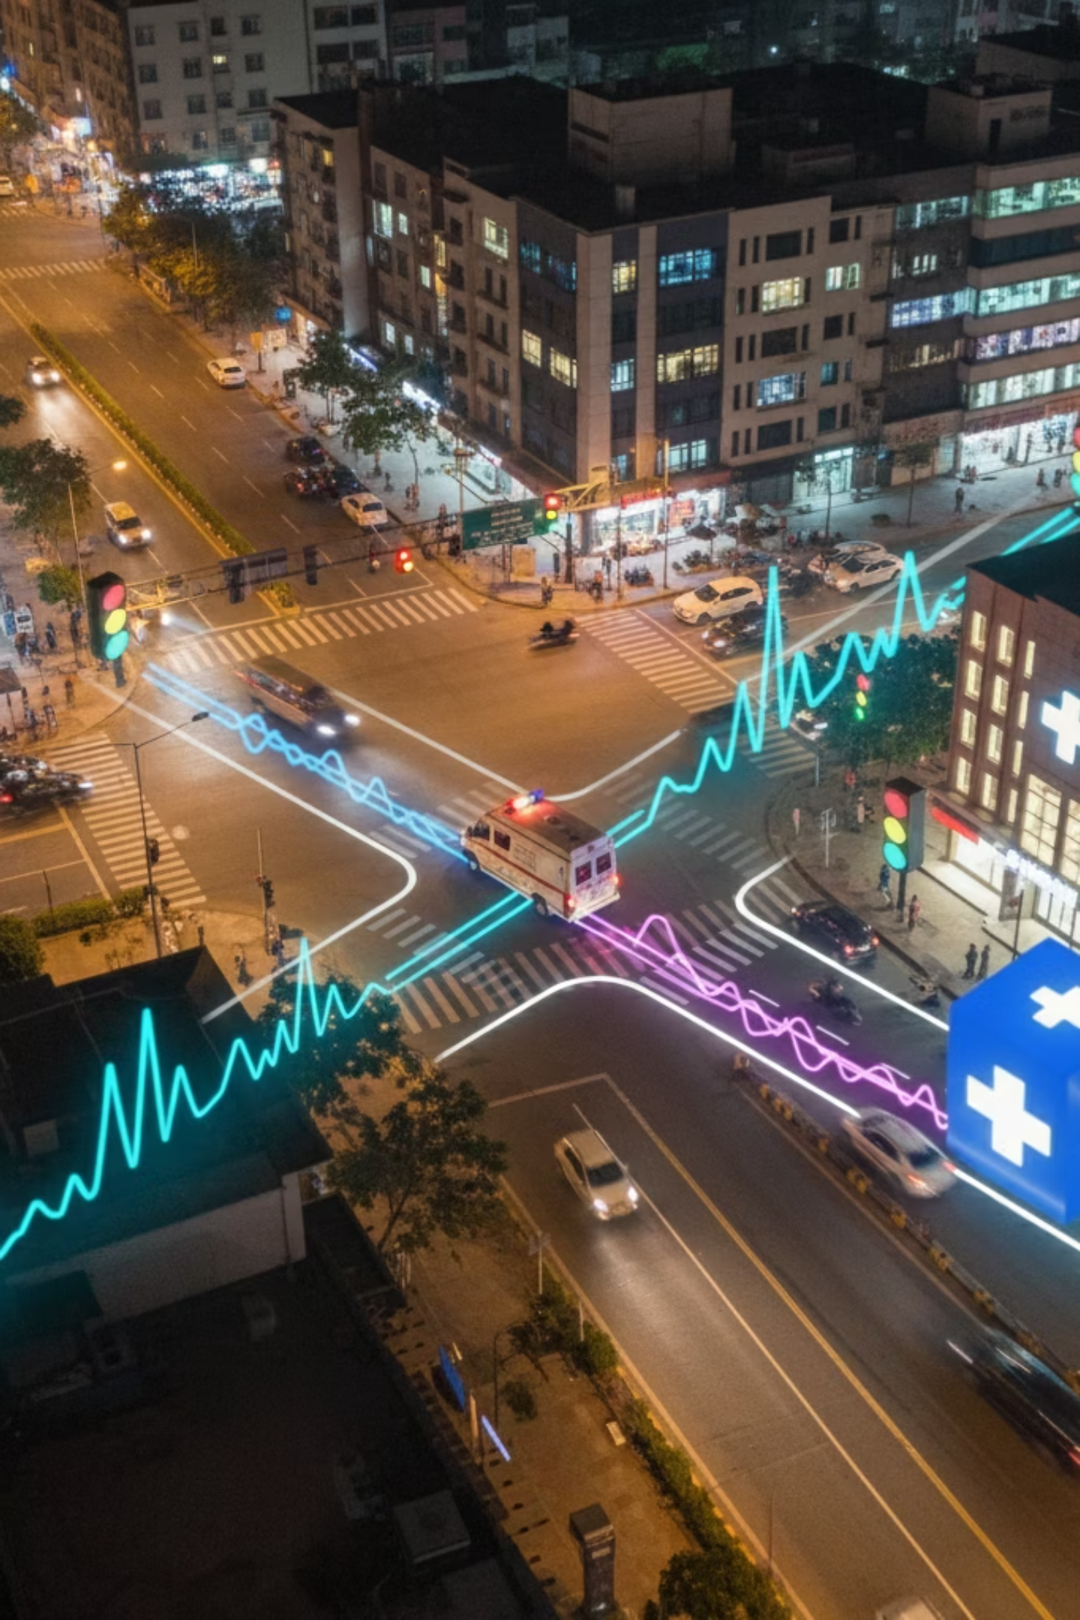
How It Works: The Tech Stack
Ambulance Detection
AI Route Optimization
DSRC-C/V2X sensors identify emergency vehicles up to 1.5km away, instantly alerting our central system
Machine learning algorithms analyze real-time traffic data, predicting optimal paths and updating every 10 seconds
Signal Coordination
Hospital Preparation
IoT controllers automatically synchronize traffic lights to create green corridors along the optimized route
End-to-end encrypted app transmits critical patient vitals to hospitals, ensuring readiness upon arrival

Slide 7

A Life-Saving Investment
10K+
50%
₹5L
Lives Saved Annually
Delay Reduction
Cost Per City
Nationwide adoption could save 8,000-10,000 lives per year through reduced ambulance delays
Cut ambulance response times in half, increasing survival rates by 7-10% per minute saved
90% cheaper than Western alternatives, making large-scale deployment financially viable
Revenue Model: Hospital subscriptions (₹3K-5K monthly) for real-time patient updates, plus municipal partnerships for system deployment and maintenance.

Slide 8
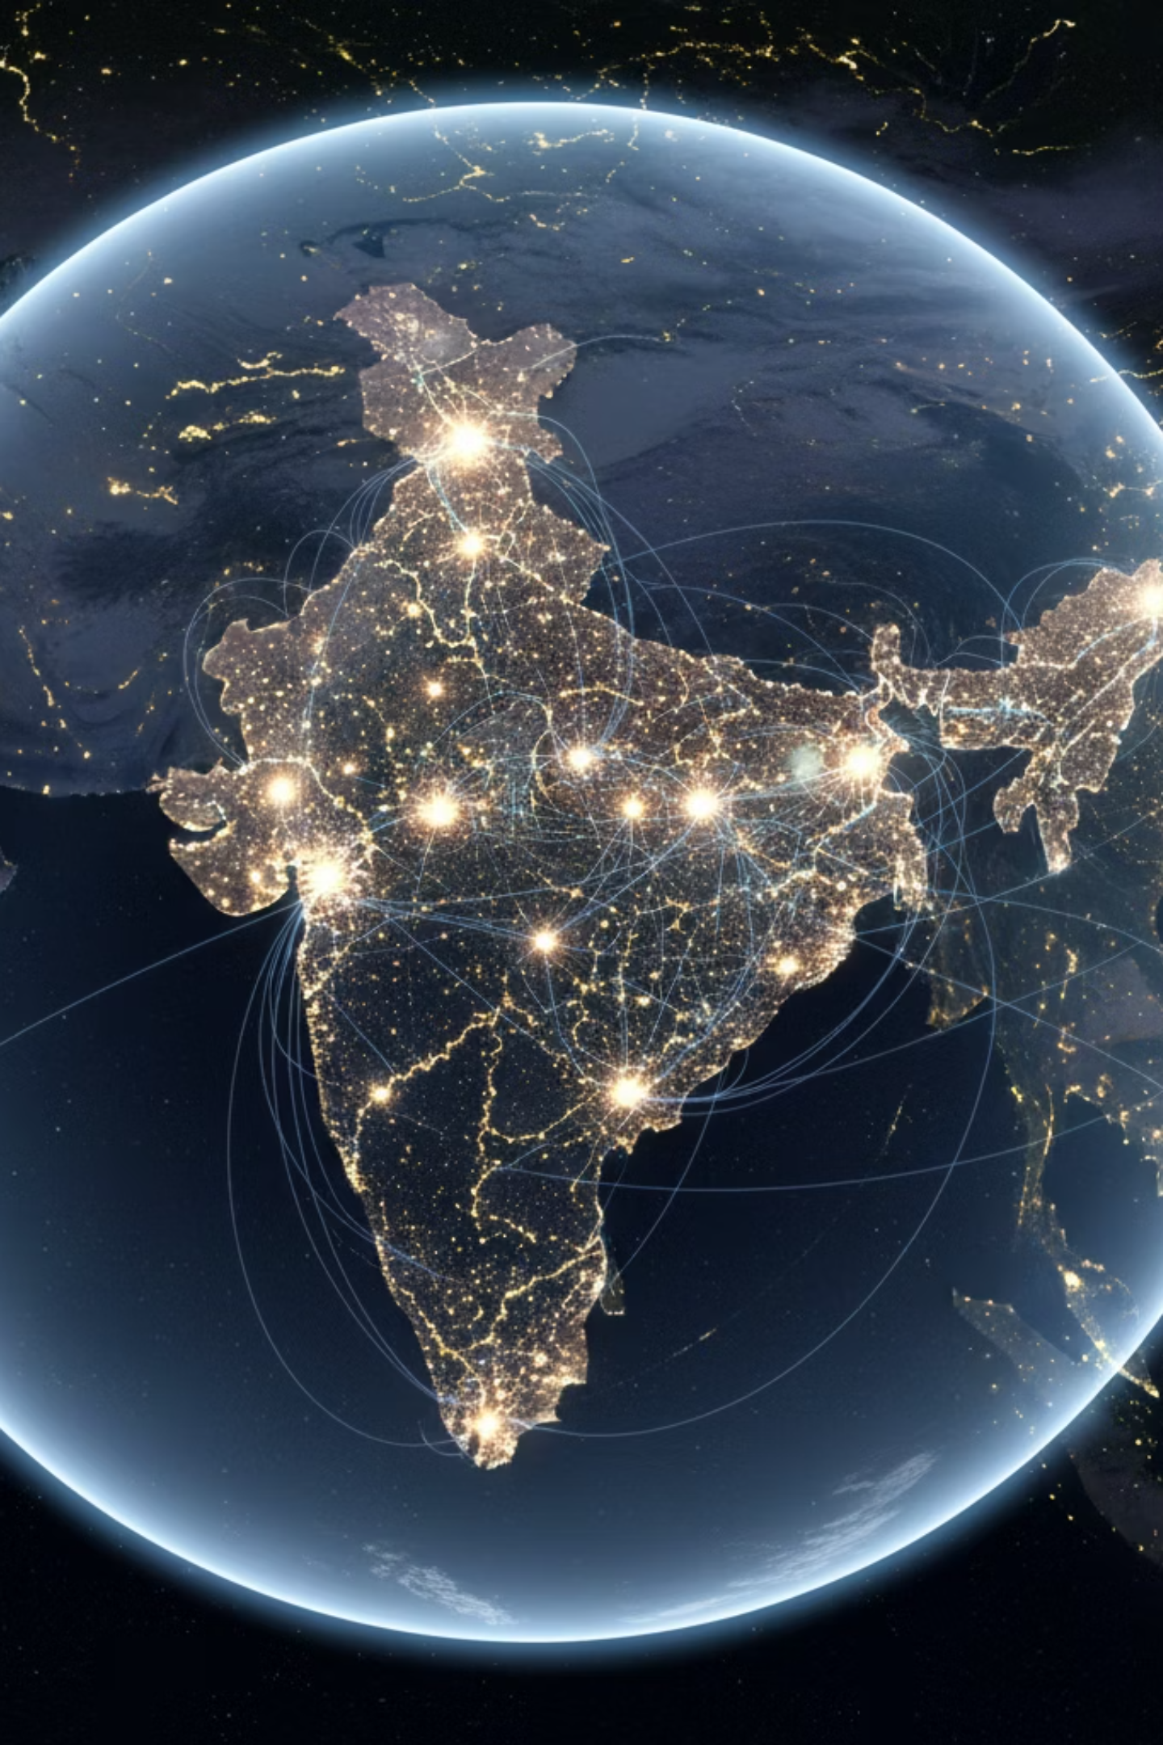
The Path to a Safer Nation
1
Year 1: Pilot Launch
Deploy in Pune/Nashik with 5 major hospitals and 50 AI-equipped ambulances. Prove concept and gather performance data.
2
Years 2-3: Metro Expansion
Scale to Mumbai and Delhi. Establish strategic partnerships with NHAI and state transport authorities.
3
Years 4-5: National Adoption
Integration with PM-JAY healthcare scheme. Deployment across 100+ cities nationwide.
Our phased approach ensures sustainable growth while building the infrastructure for nationwide emergency response transformation.

Slide 9
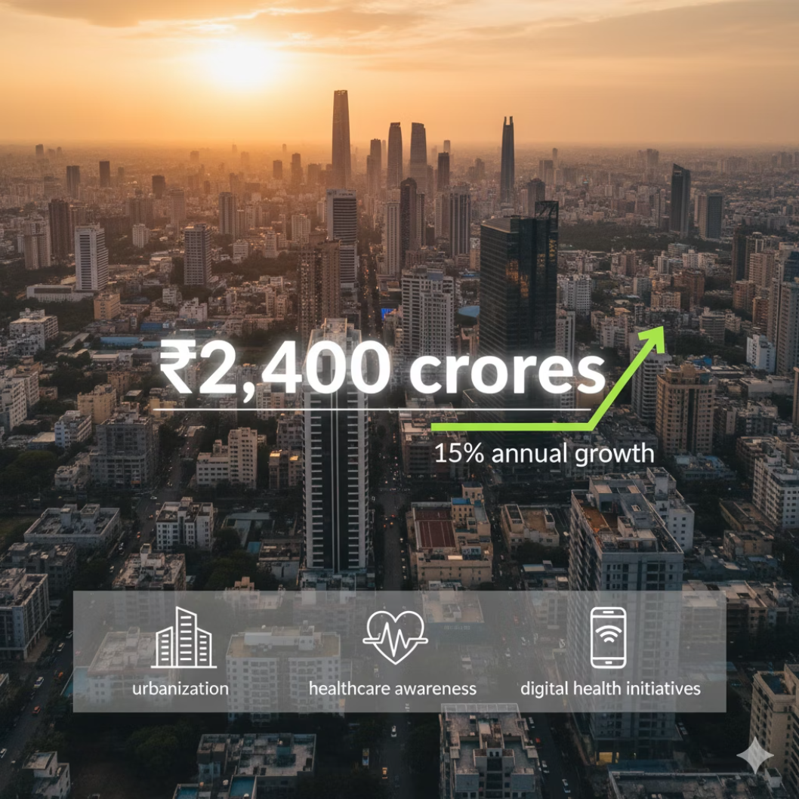


Market Opportunity
Massive Addressable Market
India's emergency medical services market is worth ₹2,400 crores and growing at 15% annually. With over 700 cities requiring modernization, the opportunity is unprecedented.
Key drivers: Rising urbanization, increasing healthcare awareness, and government digital health initiatives create perfect conditions for adoption.
15%
700+
Annual Market Growth
Cities Need Modernization

Slide 10



Why Now? The Perfect Storm
Policy Support
National Digital Health Mission and Smart Cities initiative provide regulatory backing and funding opportunities
Tech Infrastructure Ready
5G rollout and IoT adoption make advanced traffic management systems finally feasible at scale
Healthcare Crisis
COVID-19 highlighted critical gaps in emergency response, creating urgency for systematic solutions
The convergence of technology readiness, policy support, and urgent need creates an unprecedented window for Suraksha-Path to revolutionize emergency response across India.

Slide 11

Smarter Roads, Faster Help, Saved Lives
Every second matters in an emergency. Suraksha-Path transforms those seconds from obstacles into lifelines, ensuring that help reaches those who need it most—when they need it most.
Join us in building the emergency response system India deserves.
Team Suraksha-PathReady to save lives through technology

